Slide 1


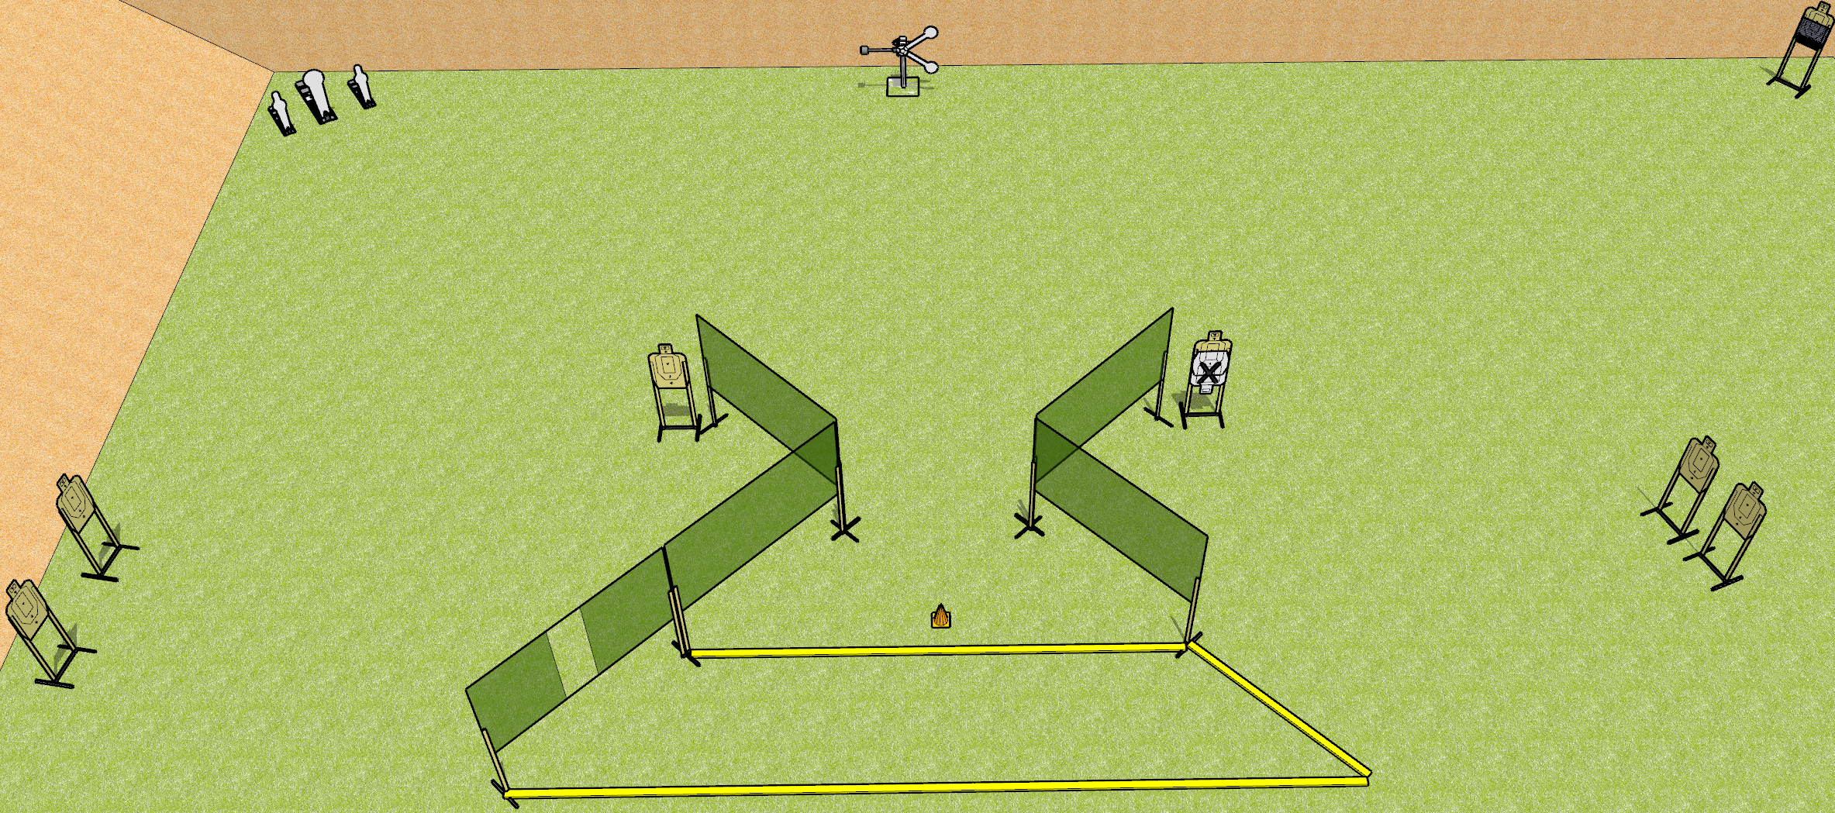
 | Dothan Gun Club – USPSA Match Far Far Away Course Designer : Drew Coleman
START POSITION : Outside the shooting area, toes touching rearmost fault line, wrists below belt
GUN READY CONDITION : Pistol loaded and holstered. PCC loaded, held with both hands, shouldered, safety on, pointed at orange cone. |  | SCORING: Comstock, 19 rounds TARGETS: 7 paper, 5 Steel SCORED HITS: Best 2 on paper, steel until down START-STOP: Audible, last shot RULES:
STAGE PROCEDURE: Engage targets as they become available from within the fault lines.

Slide 2
Far Far Away
Written Stage Briefing
Far Far Away is a 19 round, 95 point, Comstock medium course. There are 7 USPSA targets, 2 USPSA mini poppers, 2 falling plates, and 1 Colt popper. The best two hits on paper will score, and steel must fall to score. The start signal is audible.
The swinging plate target is activated by the rightmost mini popper, and must be activated before being engaged. Please check the activator prior to walkthrough and set it the same way every time. The target is not disappearing.
Handgun start position is toes touching rear fault line, wrists below belt. Handgun is loaded and holstered.
PCC start position is toes touching rear fault line, muzzle pointed at orange cone. Loaded carbine is held with both hands, shouldered, safety on.
On start signal, engage targets as they become available from within the shooting area.

